Slide 1
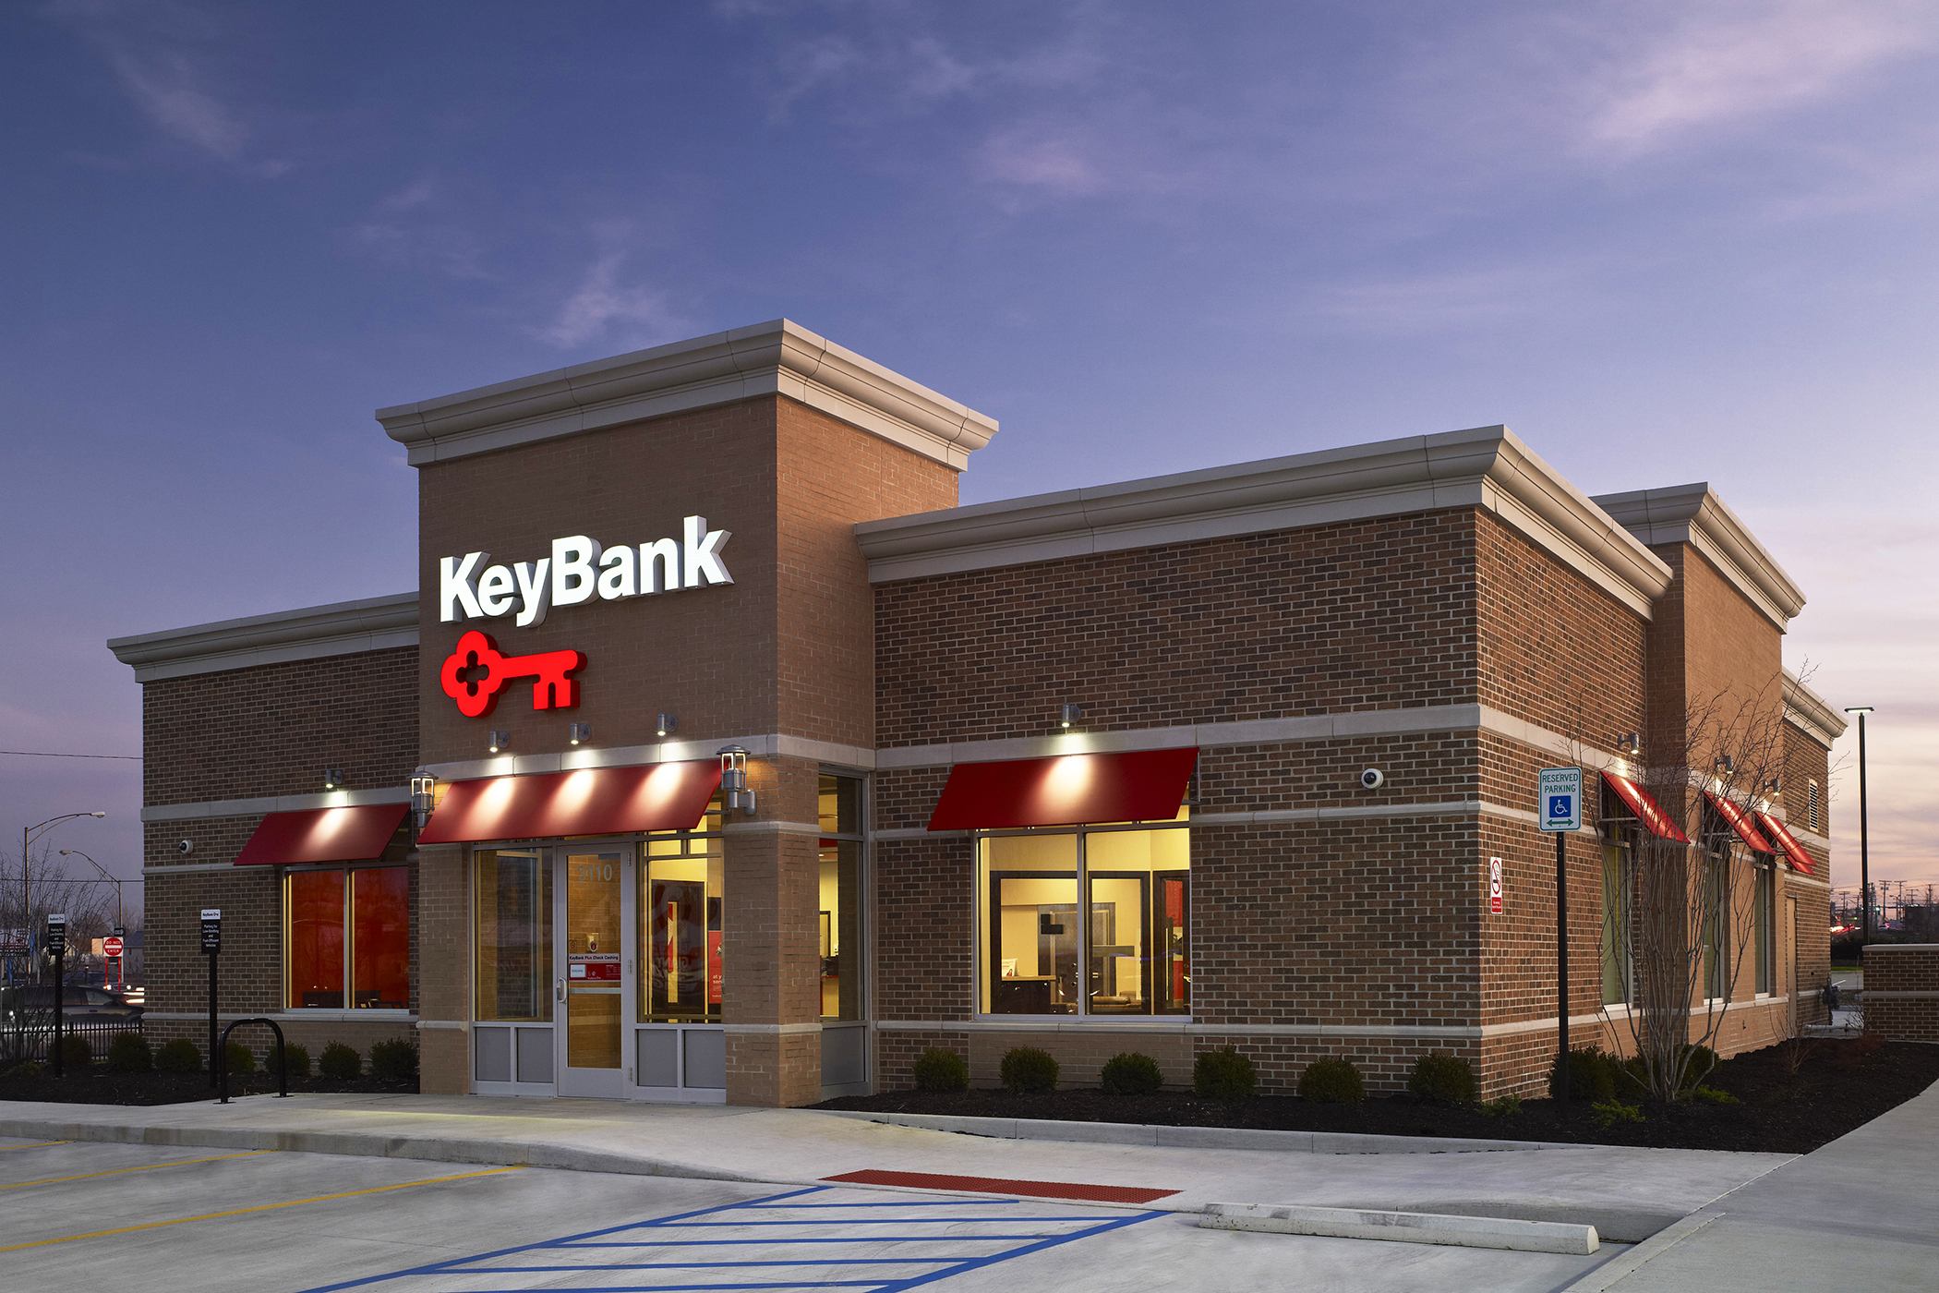
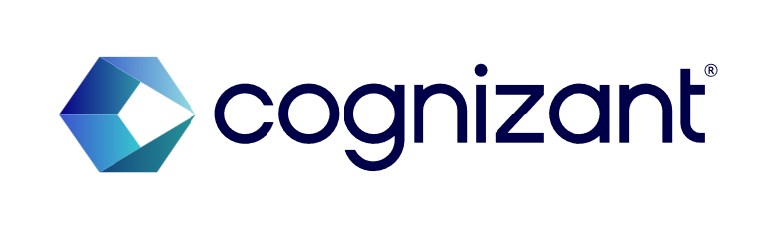
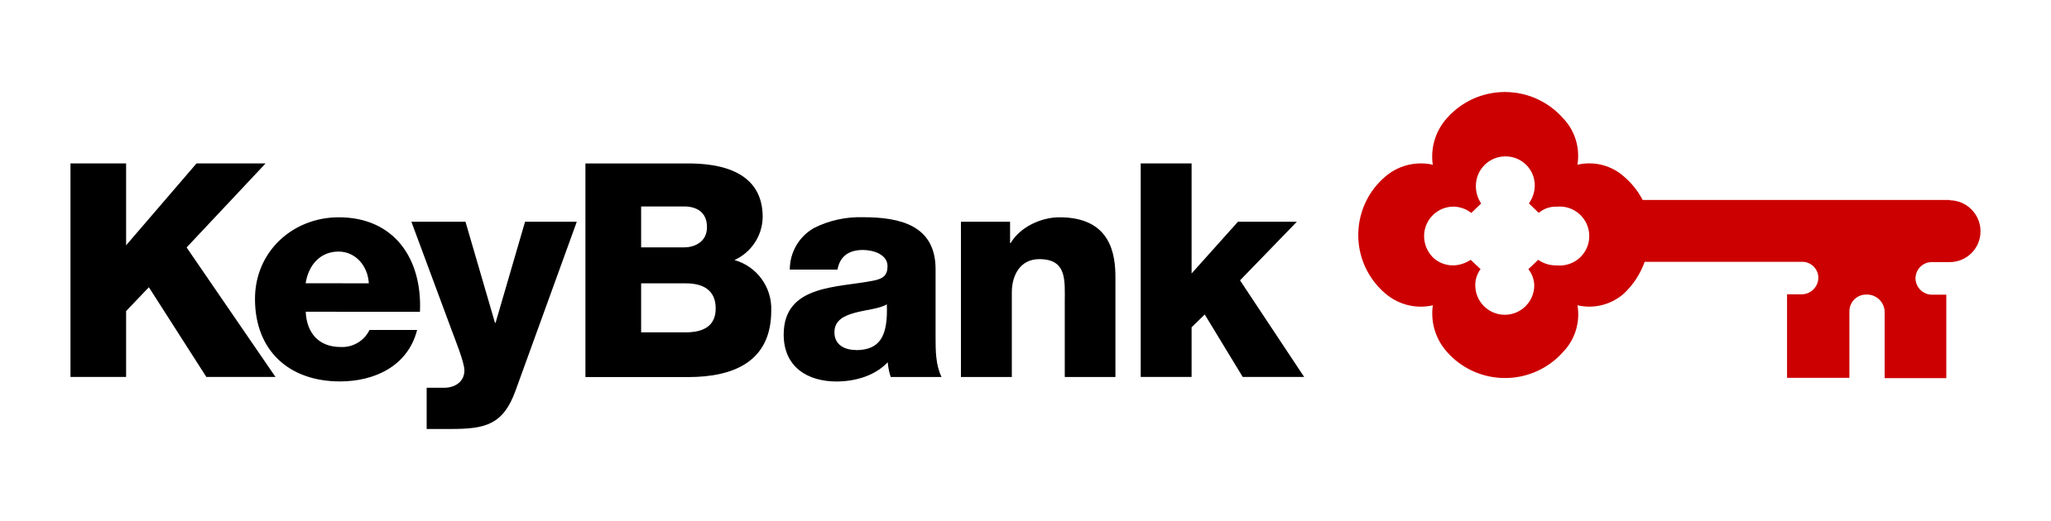
KeyBank – KeyNav Java Migration
Cognizant Proposal
January 2026

Slide 2

Executive Summary
Our Solution Highlights
Oracle Java 8 version upgrade to openJDK17 or to the nearest prior compatible version without changes to existing architecture, design, or framework
Perform JAR version upgrades and remediate deprecated code in the current JDK version as part of the scope.
Coordinate with the TLA team to update deployment scripts and CI/CD pipelines for changes related to JDK upgrades.
Request and obtain required access from the application team, including GitHub repositories, database credentials, and local setup documentation for in-scope applications.
Fix any issues introduced by the upgraded code, as identified during development, QA, or PTE testing.
Remediate the application in one lower environment and support to application team for the deployments of remediated code in remaining regions.
Perform regression testing in a stable QA environment with required database connectivity and integration with upstream/downstream systems. Leverage existing automation scripts for testing.
Provide warranty support for two weeks post-release to ensure stability and resolve any issues.
Scope
Lift-and-shift KTT, GTM, KTW, KMC, and KTM from WAS applications to Tomcat applications deployed as containers.
Coordinate with Dev and Support teams on deploying these applications to a containerized environment (assume the container environment already exists).
Migrate applications from Bitbucket to Gitlab in the process, which would include coordinating with the Dev and Support teams to create appropriate pipelines.
Preparing runbooks, deployment artifacts, and other necessary documentation to facilitate getting the migrated applications into production
QAS testing of migrated applications, including performance testing

Slide 3
Cognizant has designed a solution to cater to The KeyBank’s objectives
The KeyBank aims to evolve and finalize their commercial Oracle Java Exit Strategy by 2026. They plan to transition smoothly to an opensource JDK alternative with long-term support (LTS) before their current Oracle JDK contract ends in Dec 2026.
Cognizant Proposition
GenAI productivity factored in - 20% via GitHub Co-Pilot/Google’s Gemini
Demonstrated Capabilities to deliver with high quality
Aligned to The KeyBank’s Blueprint & Roadmap
Robust Governance & Leadership Commitment
Deep inventory insights and application landscape knowledge and incumbency
Our Solution Approach Highlights
4 Step Approach – Requirements Assessment, Design & Implementation, Testing & Validation and Deployment & Monitoring with multiple waves of go-live
Robust Governance – Create a robust governance with a regular cadence of program reviews. Deliver within agreed timeline
Program Delivery Team – Build a team with the best mix of skills, experience and leadership to exceed LOB’s expectations
Team Readiness– Day 1 team is ready to kick start the program
Tools & Automation – For applications remediation and testing
Outcomes
TCO reduction (Oracle Java license)
Eliminate security risks through InfoSec compliance
Technical debt reduction
Foundation for cloud Readiness

Slide 4
Milestone based delivery
Milestone | Milestone Name | Description | Target Window
Milestone 1 | Discovery & Assessment | Analyze WAS apps, dependencies, configs, Tomcat compatibility | Week 1–2
Milestone 2 | Source Migration& start development | Move Bitbucket repos → GitLab, rebuild pipelines, local development in tomcat workspace, change dependencies | Week 2–4
Milestone 3 | Containerization & configuration | Create Tomcat images, Dockerfiles, config updates, firewalls, access set ups | Week 4–8
Milestone 4 | DEV Deployment | Deploy to DEV containers, verify integrations | Week 4–8
Milestone 5 | Documentation | Prepare runbooks, configs, deployment artifacts | Week 4-8
Milestone 6 | QAS Testing | Functional, regression, performance testing | Week 6–12
Milestone 7 | Production Cutover | Deploy to PROD | Week 12–14

Slide 5
Solution Deep Dive

Slide 6
Solution Approach – Oracle Java 8 to OpenJDK17 version Upgrade
Approach
Req. Assessment
Design & Implementation
Testing & Validation
Deployment & Validation
Handover & Warranty
Input
Inventory of server and environmental Report
Dependency map
API map
Application Architecture
Migration Road map
Deployment & installer updates
Build Tools & Dependencies
Readiness of Test env. For
Open JDK 17+.
Existing Test Scripts.
Existing Test assets-Requirements,
past execution reports, Plan , strategy etc.
Deployment Plan
Rollback Plan
Wave plan
Testing Plan
Cutover Plan
Monitoring & alerts
Test report
Identify the SPOC from The KeyBank team.
Access to the environment
Requirements Gathering
Remediation plan
Activities
Getting the inventory details
Understanding Application Architecture and dependencies.
Understanding the utilization pattern each JDK stack application.
Document the assessment findings
Remediation Workflow design
JDK upgrade landscape design
Categorize applications based on complexity
Rollback Plan
Develop migration & upgrade wave plan
Develop testing plan
Plan Cutover
Updating all related dependencies to the latest versions.
Update Envt variables, namespaces
Update GitHub for Test Automation Repo
Updation of test automation framework.
Execute the Test scripts-Smoke Tests.
Regression execution.
Execution E2E Integrated Test workflows
Leverage the existing tool in middleware environment
Deploy application in Tomcat server environment
Connect with Monitoring & alert team to provide recommendations.
Regression testing
Issue resolution during testing
Sync & Cutover
Knowledge transfer
Ensure RFC’s closure
Deliverables
Inventory of Java Runtime
Application Compatibility Report
Application maintenance window
Application dependency details
JDK upgrade approach
Delta Architecture document.
Detailed Migration & upgrade strategy,
prioritization, waves, Checklists
Rollback Plan
Testing Approach
Cutover plan
Scalable Up &Running Test Envt
Detailed Test plan..
Test execution Report.
Captured issues
Compiling the code & validation post upgrade
Summary of migration report
Sign off from app owners.
Warranty support
Solution Tenets
Cost Optimization
Gen AI based Conversion
Minimal Disruption
Skilled Team
Reduce licensing and infrastructure costs by moving to open-source runtime
Increasing efficiency & quality while performing JDK upgrade using GitHub Copilot/ Google’s Gemini
Retain core business logic and workflows during migration.
Phased rollout plan to reduce risk
Team of Skilled People with know-how of currency upgrade.

Slide 7

Accelerators
Area | Accelerator Name | Details
JDK Upgrade | 1. GitHub Copilot with Agent Powered by Cognizant’s Prompt Library 2. OpenRewrite | Application Assessment Analyzes codebase for Java EE dependencies like EJB, JMS, JTA, and JPA. Flags areas that are need refactoring Helps visualize migration tasks and dependencies. Code Transformation Suggestions Code changes for EJB, JMS, JPA, and JTA components to align with TomEE PluME standards. Refactors JMS code to work with external brokers (e.g., ActiveMQ) compatible with TomcatEE. Dependency & Runtime Upgrade Assists in upgrading Java versions (e.g., from 8 to 17 or 21). Build & Unit Test Updates Maven/Gradle build files for OpenJDK17 version. Generates or migrates unit tests to validate refactored components and fixing vulnerabilities in new code Custom Task Creation Allows to create custom migration tasks based on previously migrated code. Applies consistent remediation patterns across similar modules. Cognizant® Prompt Library: can be used to increase developer productivity OpenRewrite: Provides ready-made recipes for upgrading from Java 8 → 17/21 Identifies and replaces deprecated APIs with recommended alternatives. Ensures correct source and target compatibility in build configurations. Automates safe, large-scale refactoring for consistent JDK migration
Google’s Gemini |  | Automated Dependency Mapping API Incompatibility Resolution Context-Aware Explanation Unit Test Generation Productivity Gain: 25%
Cognition’s Devin.AI |  | Autonomous End-to-End Migration Mass Parallelization Self-Healing Build Pipelines Legacy Library Replacement Security Vulnerability Remediation Productivity Gain: up to 50%

Slide 8
Application Remediation for JDK Upgrade
Assumptions
Any infrastructure needed for this migration will be set up by KeyBank with out delay.
Any integration changes like Apigee, Datapower, ISAM that involves other team efforts are not estimated
Application support team will be helping this team when ever there is a need .
No new nonhuman ids are getting created.
Minimal application refactoring; adapt only what’s necessary to make applications Tomcat‑compatible and container‑ready. No new enhancements. KTT-BKT is also assumed to be in scope.
WAS remains operational until Tomcat code is QA complete.
All pipelines rebuilt in GitLab, replacing Bitbucket pipelines.
Migrate applications one at a time to reduce cross‑dependency risks but work parallel to have code ready.

Slide 9
RACI Matrix
An indicative RACI is provided in the table below. Cognizant will discuss this further with the KeyBank stakeholders and implement the necessary governance for this program during the planning phase –
S# | Phase | Responsible | Accountable | Consulted | Informed
1 | JDK Upgrade code remediation | Cognizant Team | Cognizant Team | The KeyBank, Application Team | The KeyBank , Application Team
4 | Remediated code deployment to Tomcat Environments | Application Team | Application Team | The KeyBank , Cognizant Factory Team | The KeyBank , Cognizant Team
5 | Regression Testing & Performance Testing | Cognizant Team | Cognizant Team | The KeyBank, Application Team | The KeyBank, Application Team
6 | Release to SIT & UAT | Application team , The KeyBank | Application Team, The KeyBank | Cognizant team | Cognizant Team
7 | Release to Production | Application team , The KeyBank | Application Team, The KeyBank | Cognizant team | Cognizant Team
8 | Warranty Support | Cognizant Team | Cognizant Team | Cognizant Team, The KeyBank, Vendor | Cognizant Team, The KeyBank, Vendor
9 | Program Management | Cognizant Team, The KeyBank | Cognizant Team, The KeyBank | The KeyBank, Vendor | Cognizant Team, The KeyBank, Vendor

Slide 10
Commercials

Slide 11
Commercials
To best align with KeyBank strategic and goals, Cognizant proposes Fixed Fee pricing model as mentioned below
Milestone | Milestone Name | Milestone Fee | Total Project Cost
Milestone 1 | Discovery & Assessment | $18,834 | $188,340 (One Hundred Eighty-Eight Thousand Three Hundred and Forty)
Milestone 2 | Source Migration& start development | $37,668
Milestone 3 | Containerization & configuration | $56,502
Milestone 4 | DEV Deployment | $37,668
Milestone 5 | Documentation | $9,417
Milestone 6 | QAS Testing | $9,417
Milestone 7 | Production Cutover | $18,834
Pricing Assumptions
KeyBank to approve the payment milestones
Any scope change will go through a change request
The pricing assumes engagement duration of 3.5 months or longer.
Cognizant resources will provide services to KeyBank from U.S. and India location.
Pricing does not cover any hardware and software costs specific to this engagement. It does not include any licensing costs, including those for third-party tools. All necessary software licenses will need to be provided by Huntington Bank.
Any changes in scope, assumptions, responsibility or delays in the project schedule including onboarding due to factors beyond Cognizant's control may necessitate a reevaluation of the pricing and will follow the established change request procedure.

Slide 12
Case Study

Slide 13
Cognizant Credential for Open JDK Migration – BFSI Client
Key Highlights
Objective
The identified applications which are using Oracle JDK need to be converted to Azul Open JDK to save Licensing cost. Although both Oracle JDK and Azul Open JDK are same but there could minor differences in behavior and compatibility. It is essential to test the application thoroughly..
Migrating Oracle JDK to Azul Open JDK (Same version)
Solution Highlights, Challenges
Timeline : ~3 months
Migration plan based on application scenario grouping ( e.g. all Tomcat hosted applications )
Ecosystem / Dependency analysis for readiness to target OpenJDK
Formalizing a migration plan based on technical complexity and business criticality
Vendor support was required to make Security adjustments for component such as Applets to work at workstations
Performance testing to ensure no performance degrade
Azul JDK has offers different support models. if required, we can take professional support from Azul.
Azul JDK also has high permanence capabilities, but we have to fine tuning to achieve the optimal results
Team size: ~8 members Applications: ~30 Apps
Technology Stack:
Application Servers/Web Servers
DevOps Pipeline
Application Codebase
Workstations
Business results
License cost saving
Higher level of automation in App server and framework migration
Ease of customization to include new rules / transform server configurations
Azul provides long term support for their Open JDK distributions.

Slide 14
Thank You

